Slide 1
Forest Hills Gardens
The Community that the Glacier Built
Alfred H. Brand, PE

Slide 2
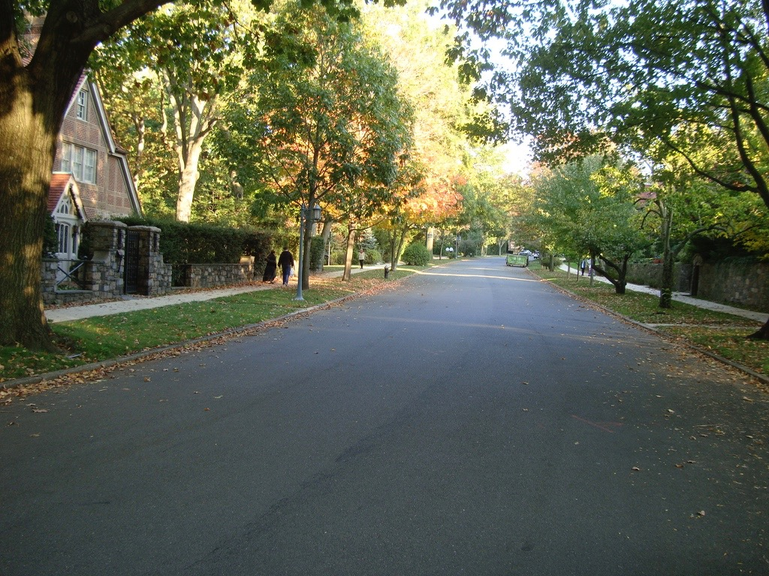
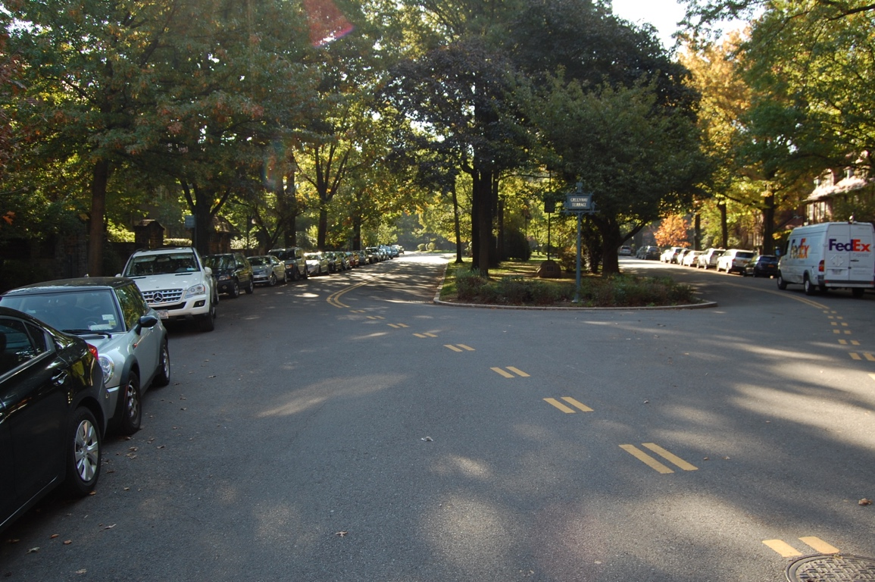
Forest Hills Gardens
Rising Slope

Slide 3
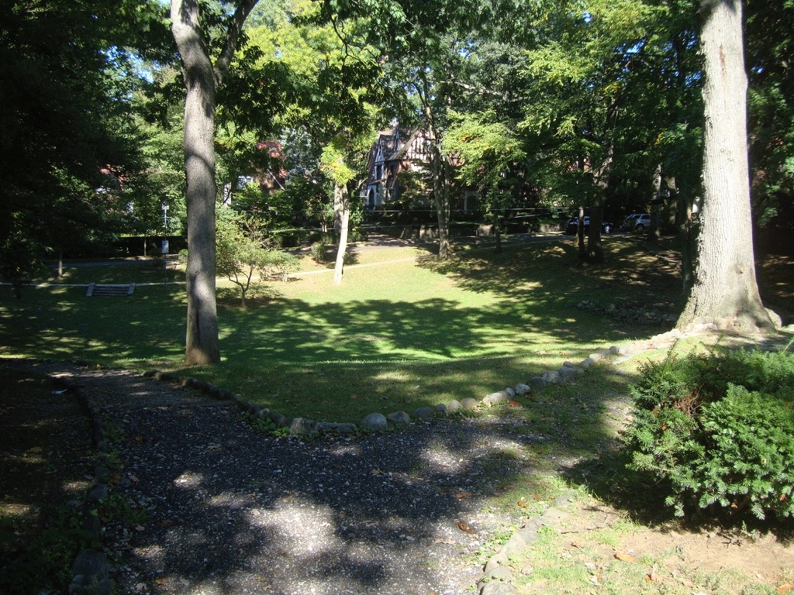
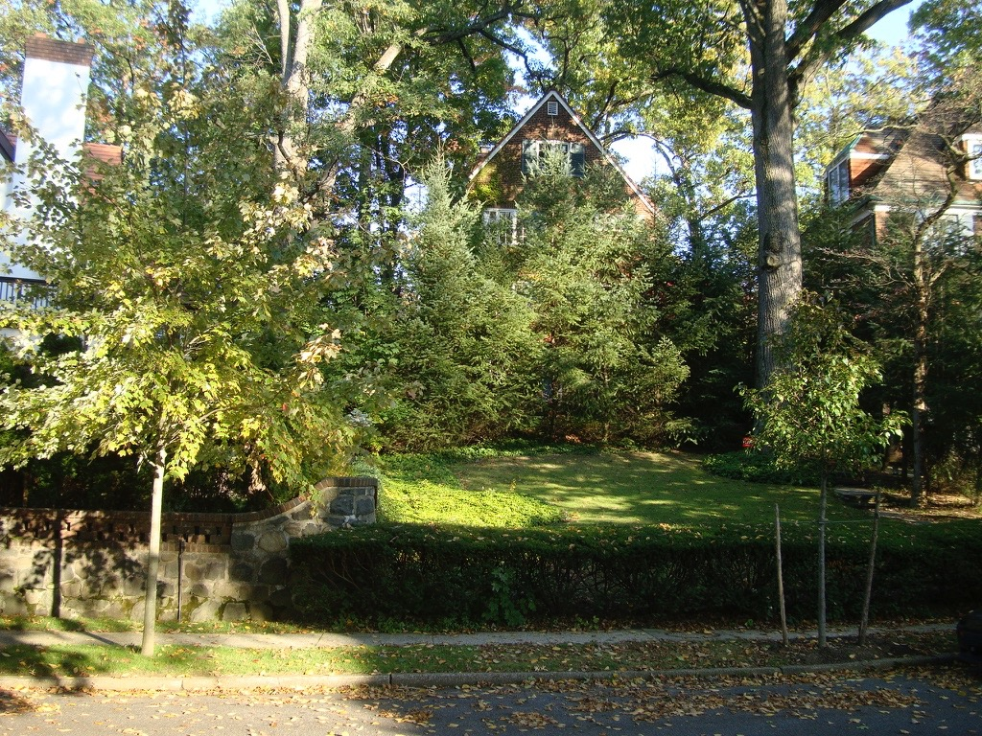
Forest Hills Gardens
Depressions and Hills

Slide 4
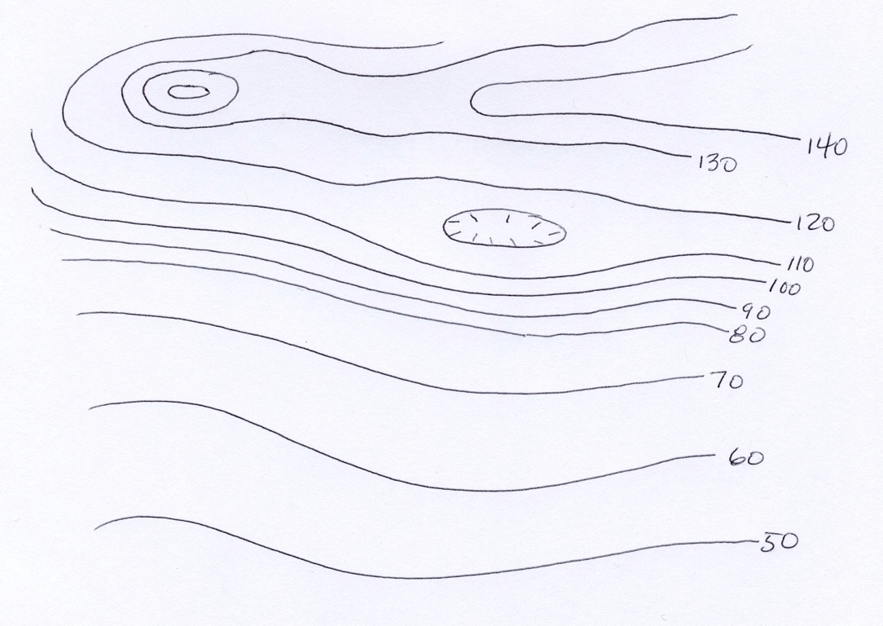
Contour Lines

Slide 5
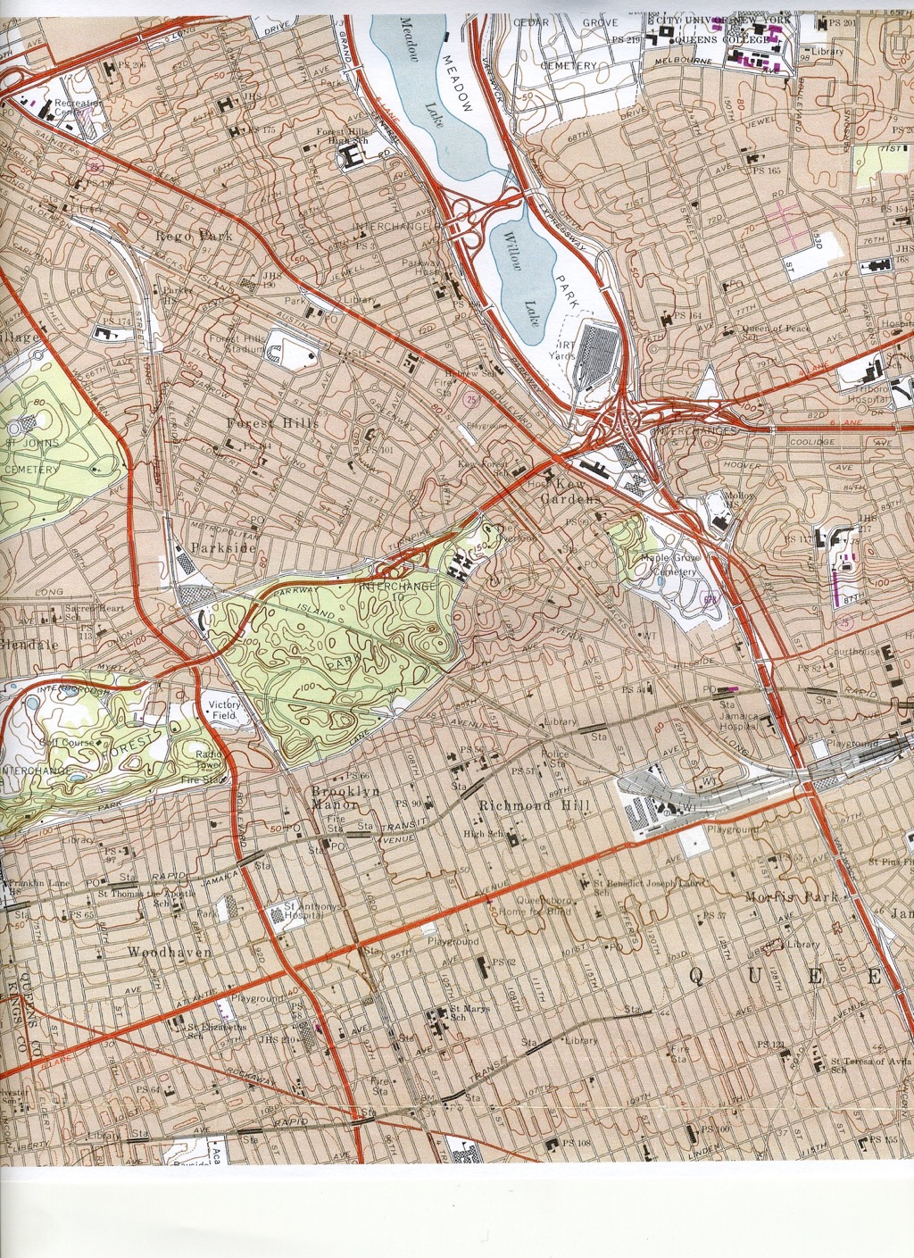
Present Day Topography

Slide 6
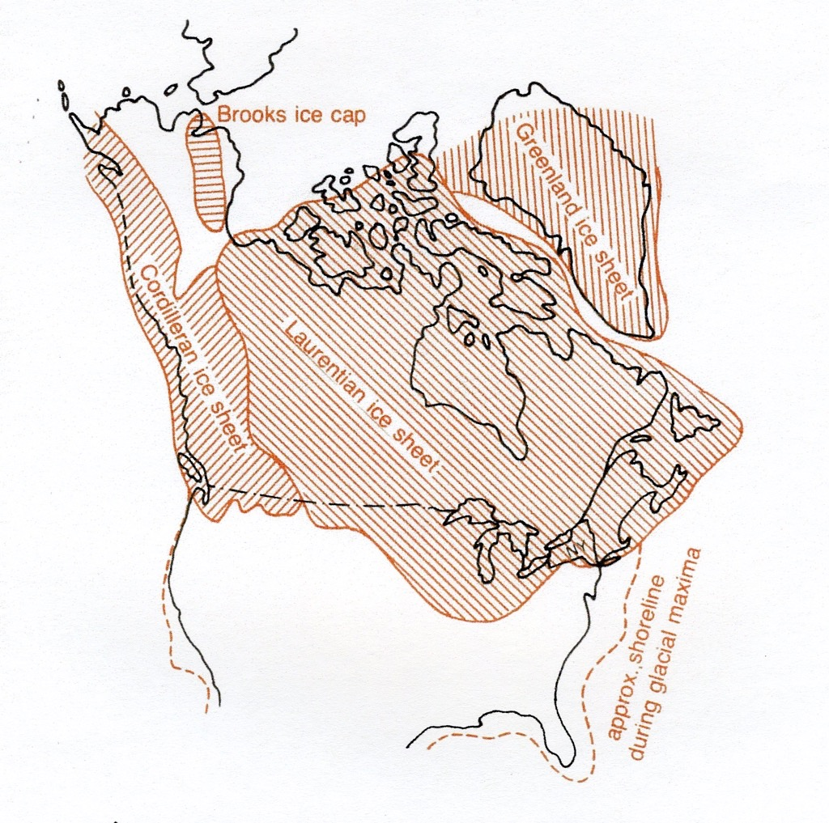
Laurentian
Ice Sheet

Slide 7
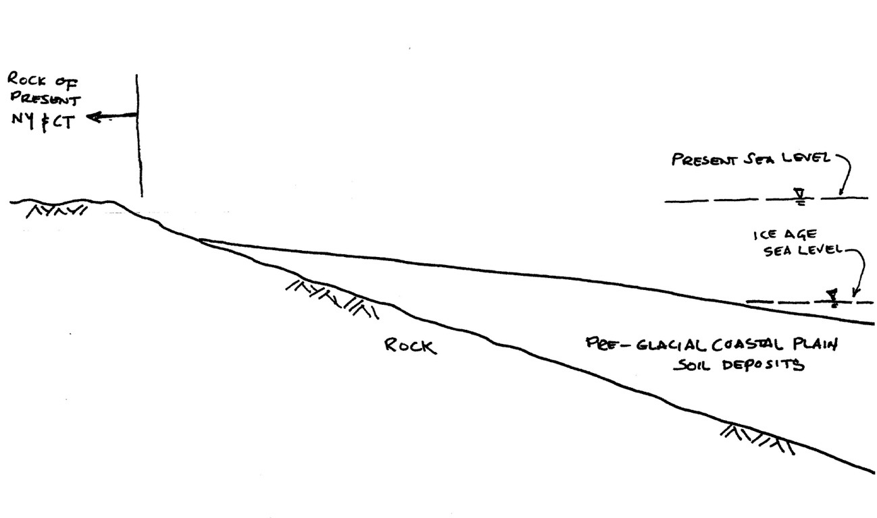
Before the Glacier

Slide 8
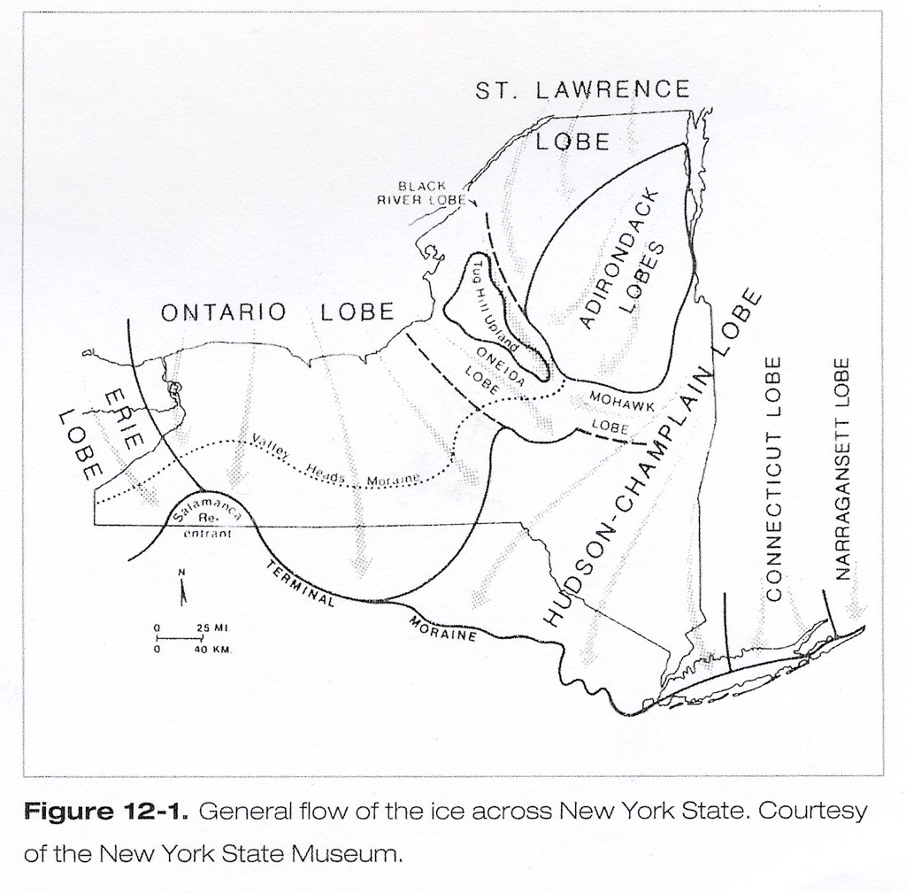
Ice Flow Directions

Slide 9
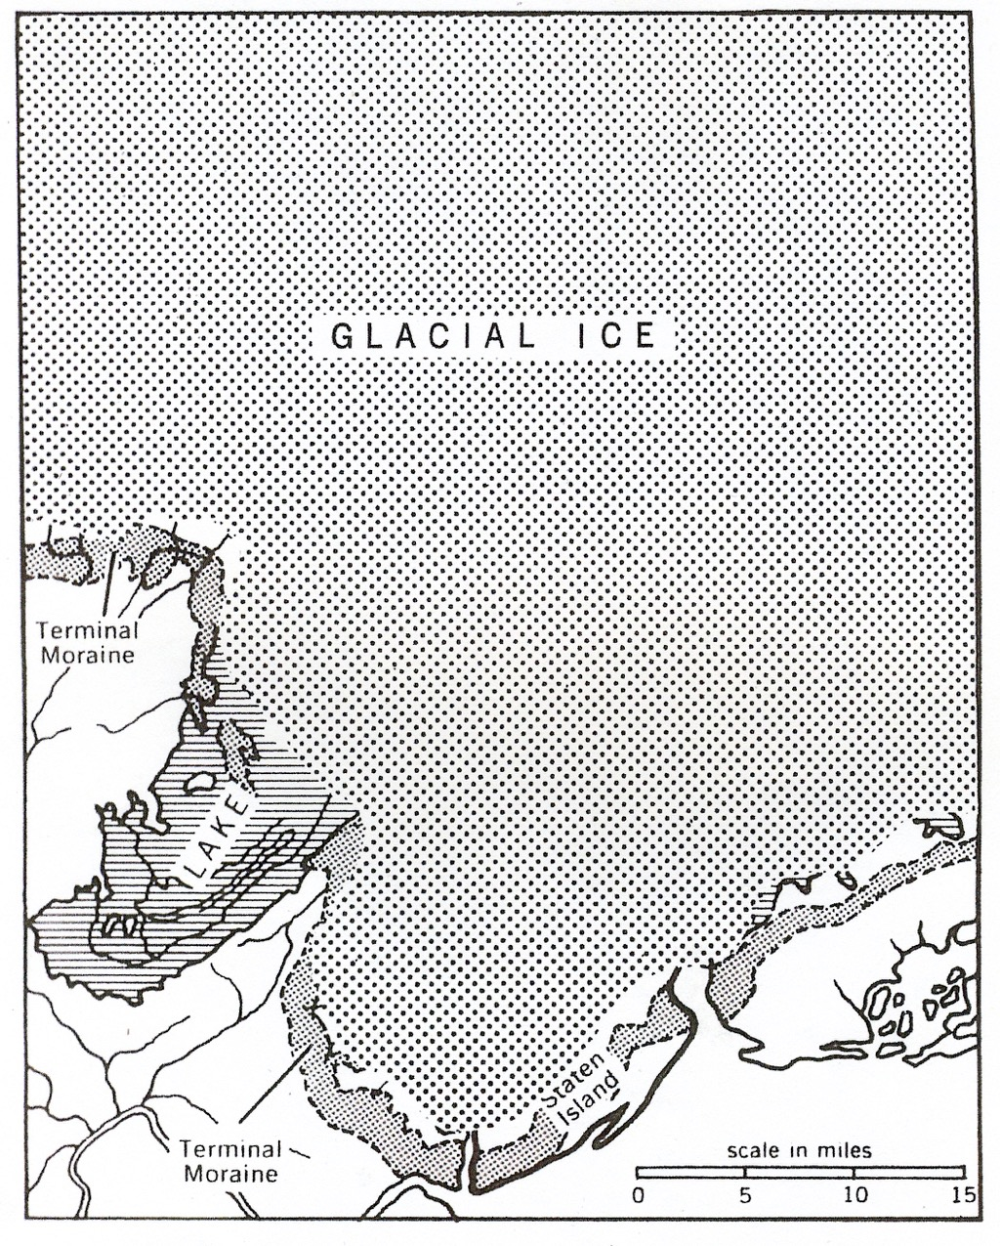
Maximum Ice Sheet

Slide 10
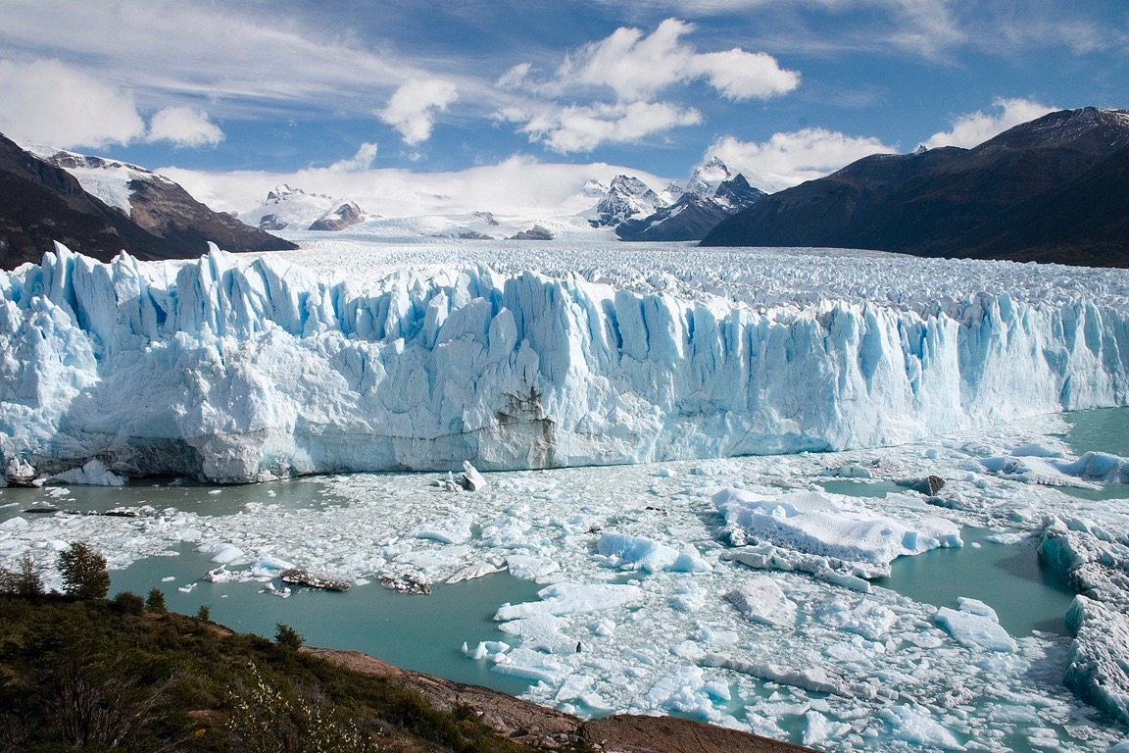
Glacier in South America

Slide 11
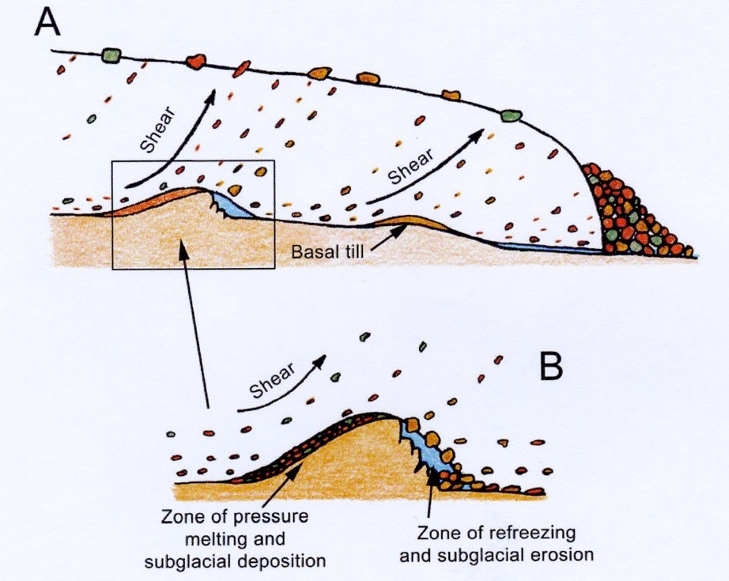
Ice Flow Action

Slide 12
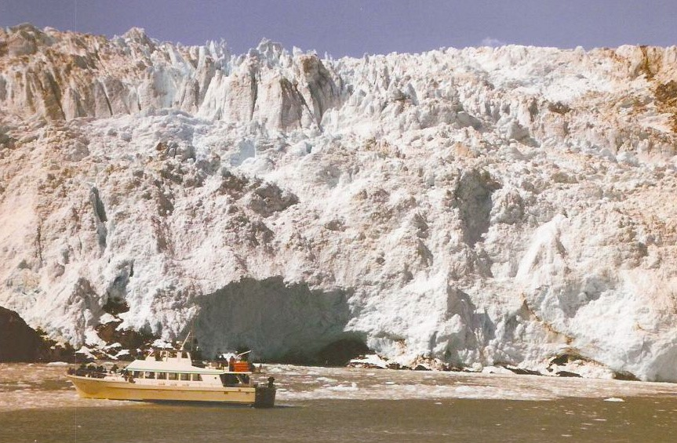
Glacier in Norway

Slide 13
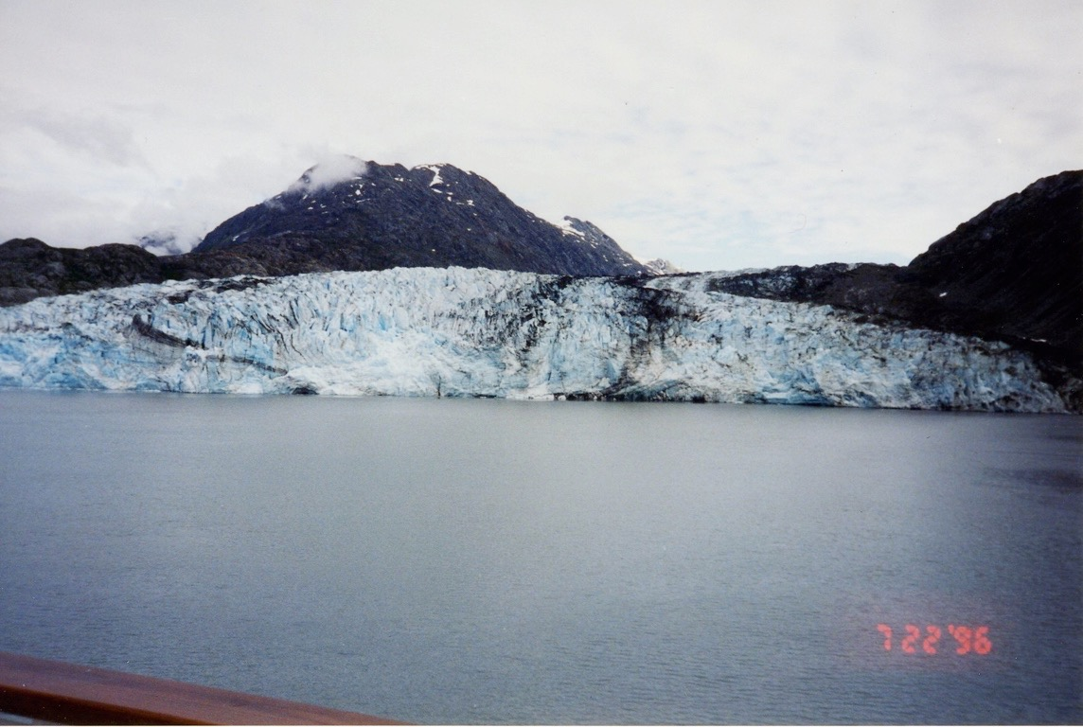
Glacier in Alaska

Slide 14
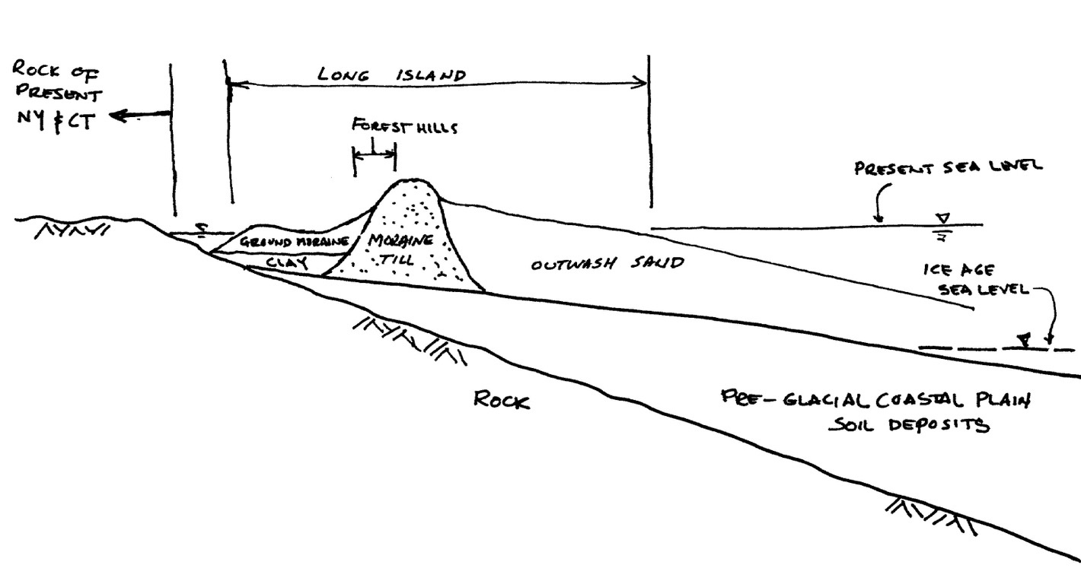
After the Glacier

Slide 15
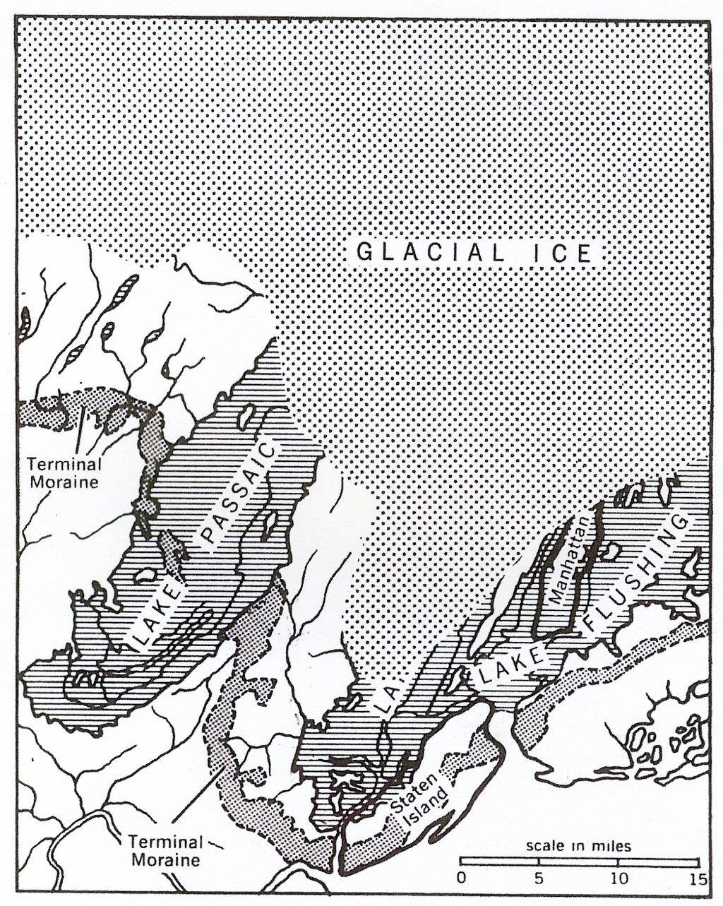
Receeding Ice Sheet

Slide 16
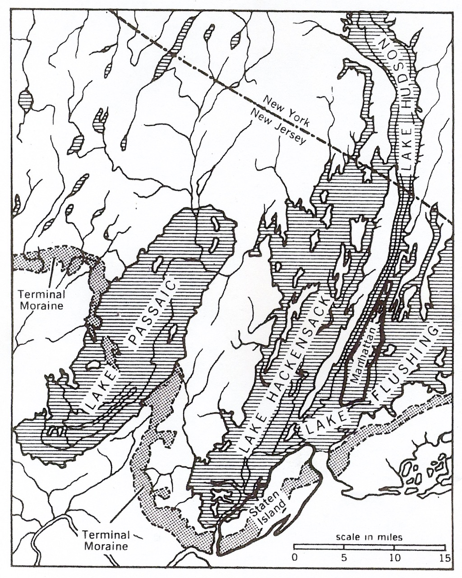
Glacier Lakes Deposit

Slide 17
After the glacier

Slide 18
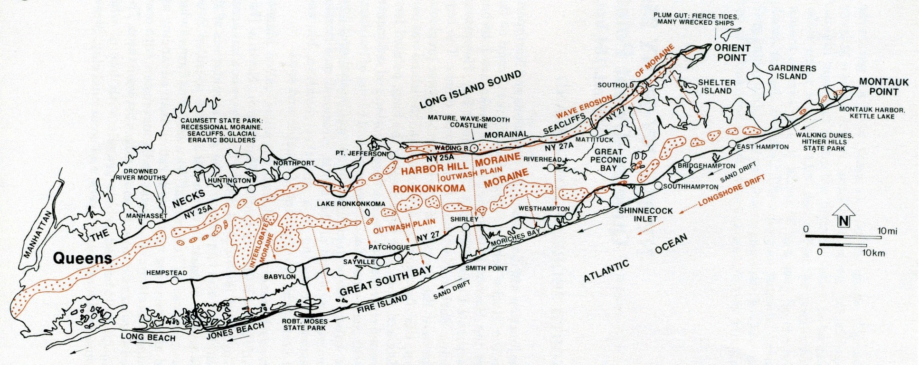
Long Island Moraines

Slide 19
Kettle Hole and Lake Formation

Slide 20
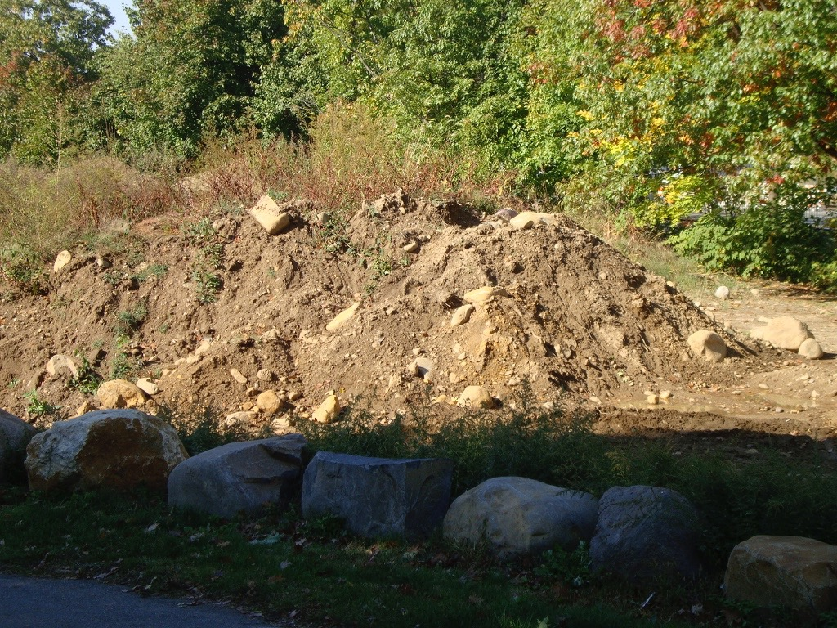
Soil of the Terminal Moraine

Slide 21
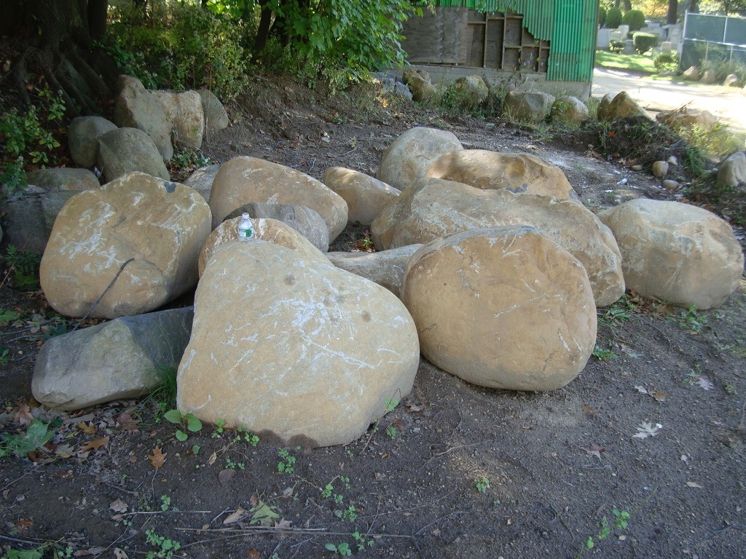
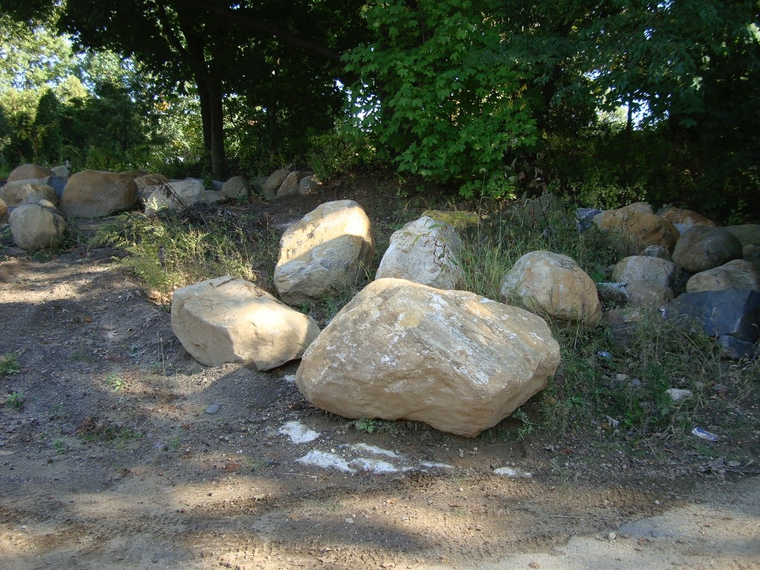
Boulders of the Terminal Moraine

Slide 22
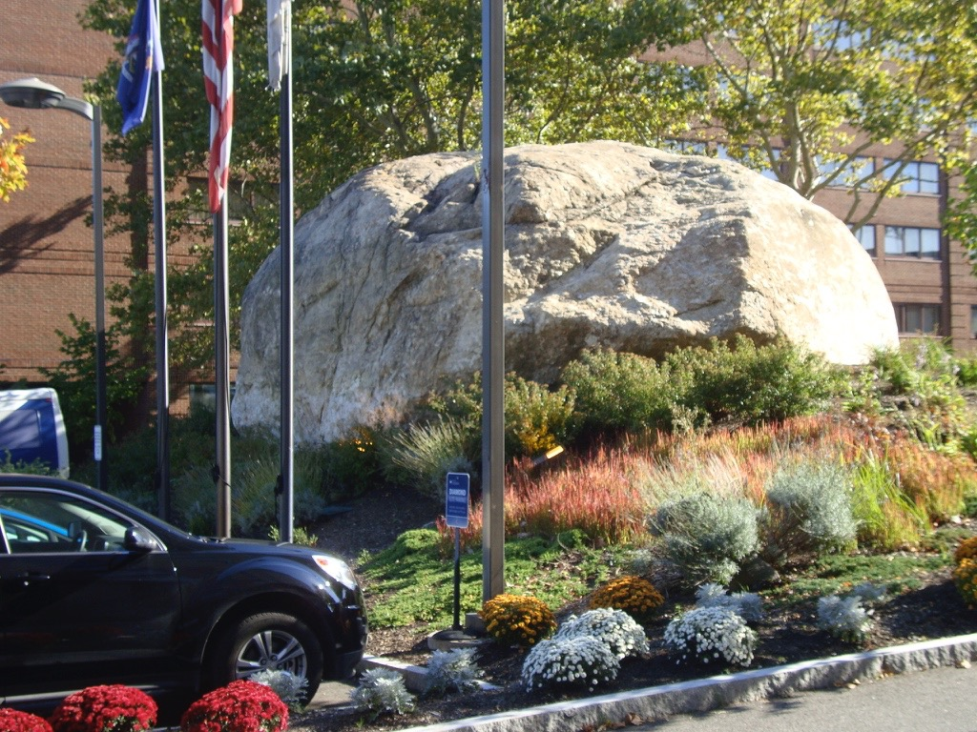
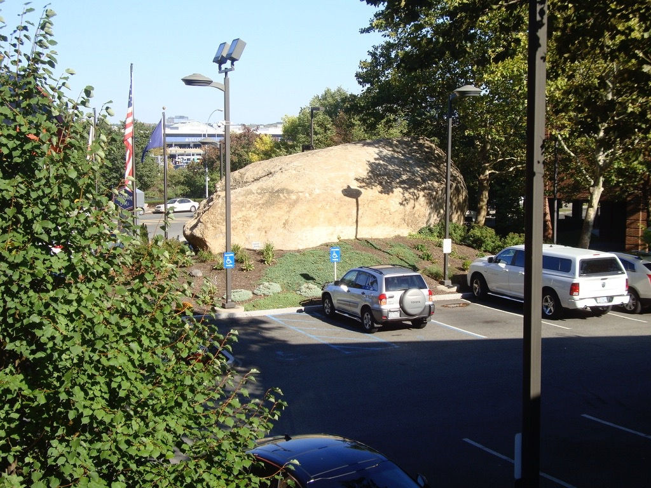
The Biggest Boulder I Have Seen

Slide 23
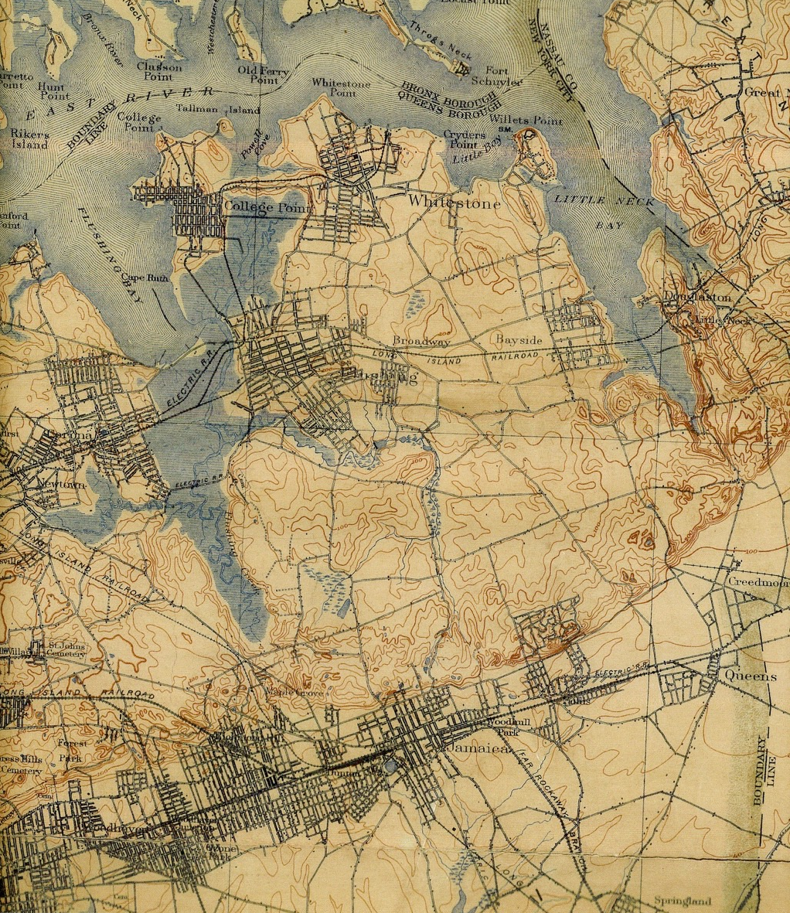
1908 Topography

Slide 24
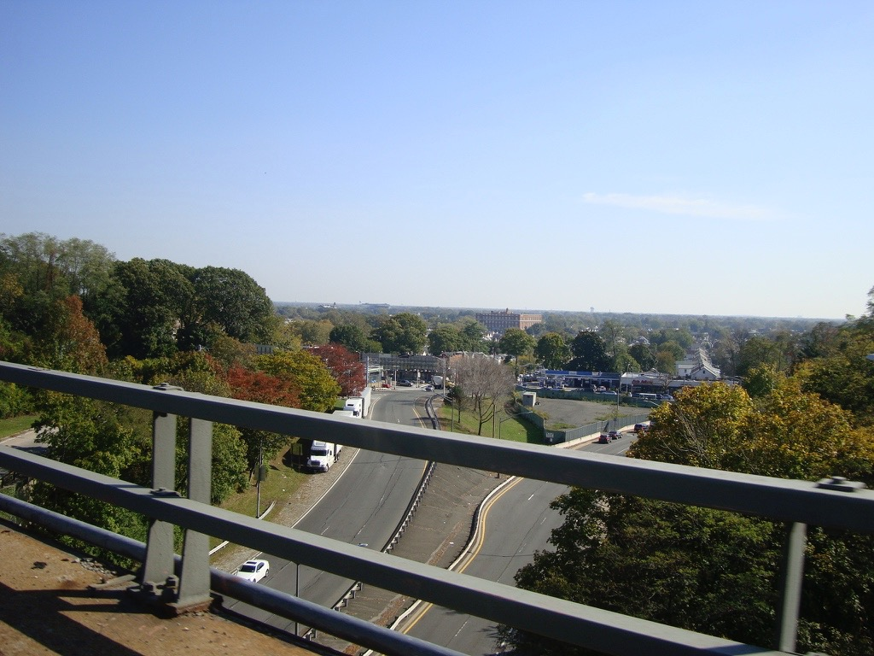
View South to Outwash Plain

Slide 25
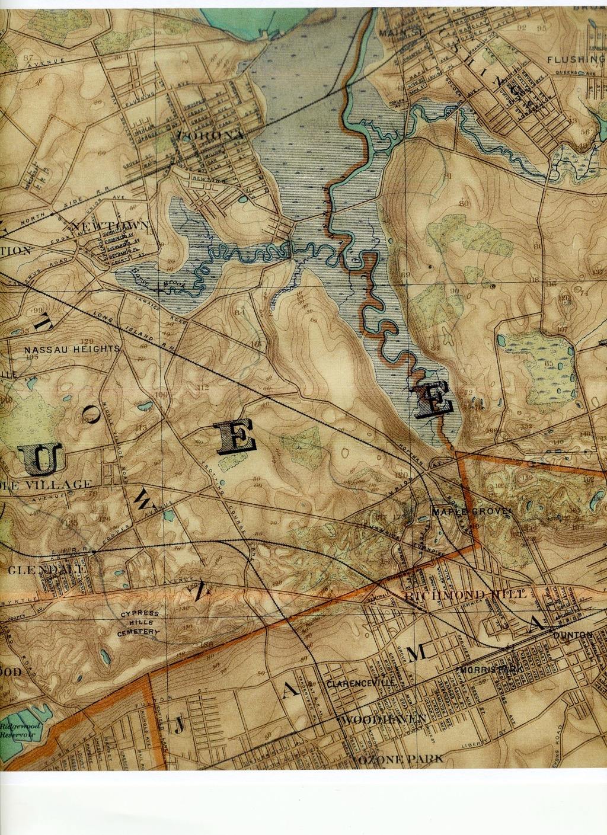
1890 Topography

Slide 27
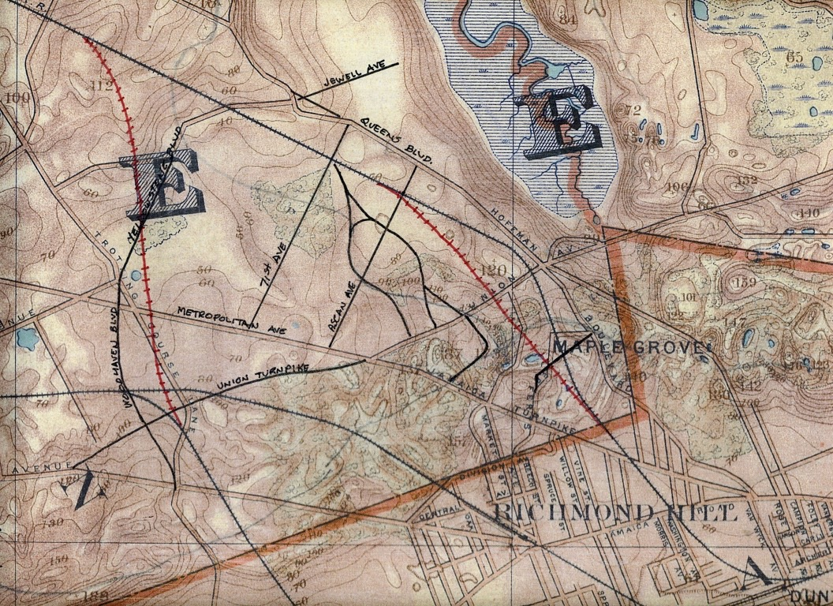
Modern Roads on 1890 Map

Slide 28
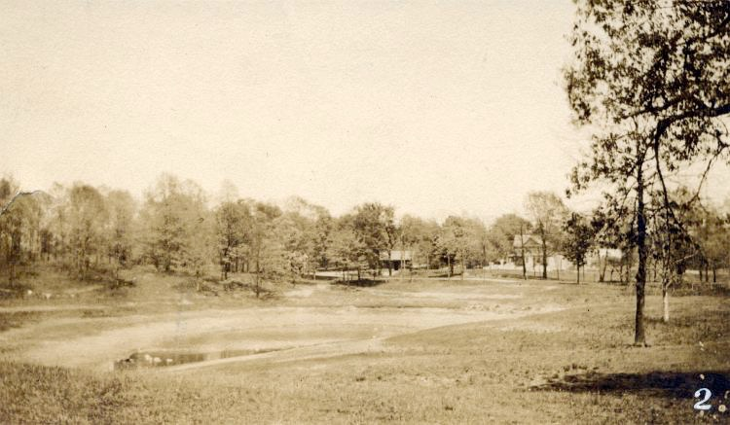
Crystal Lake, Kew Gardens

Slide 29
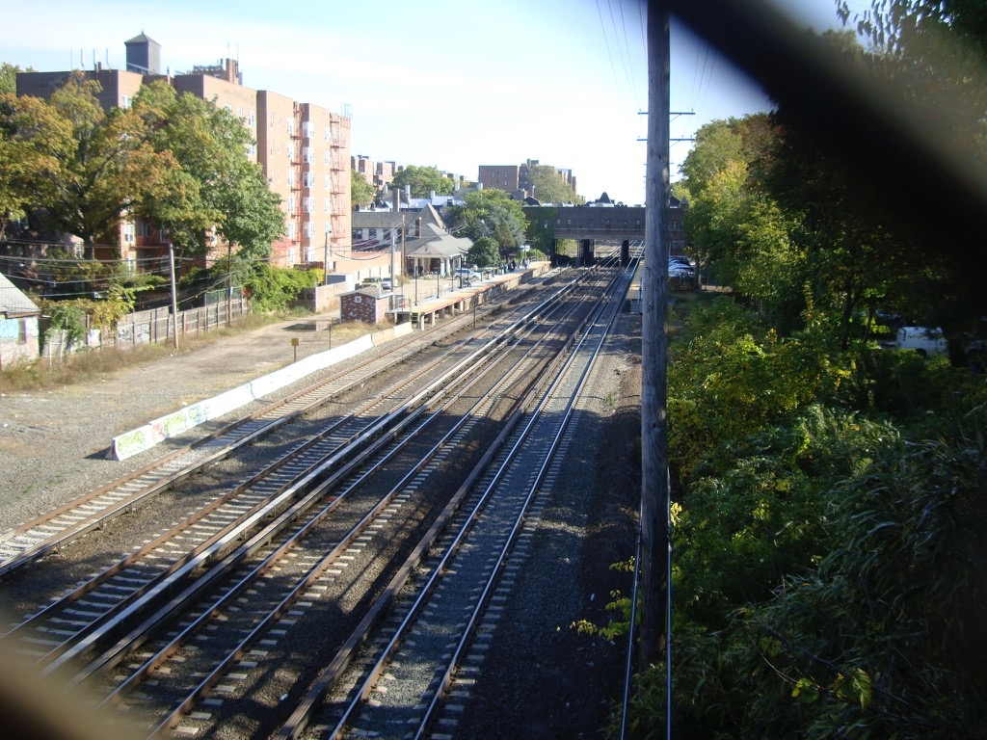
Kew Gardens LIRR Station, Built on Crystal Lake

Slide 30
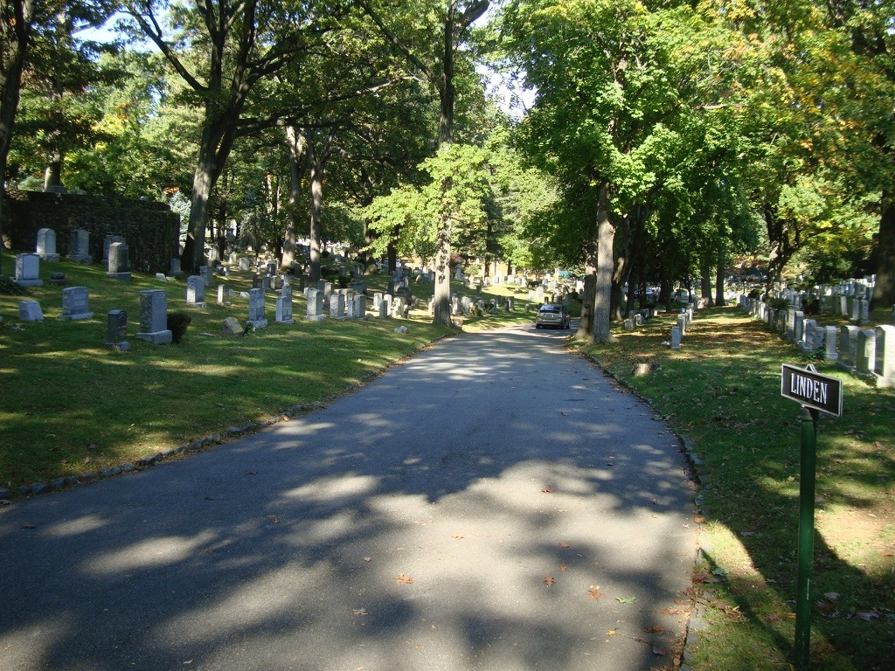
Terrain at Top of Morraine, Maple Grove Cemetery

Slide 31
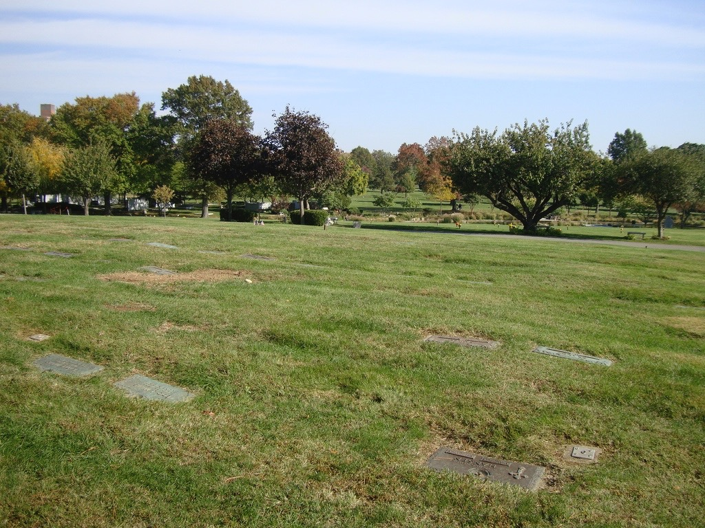
Maple Grove, Looking Towards the South

Slide 32
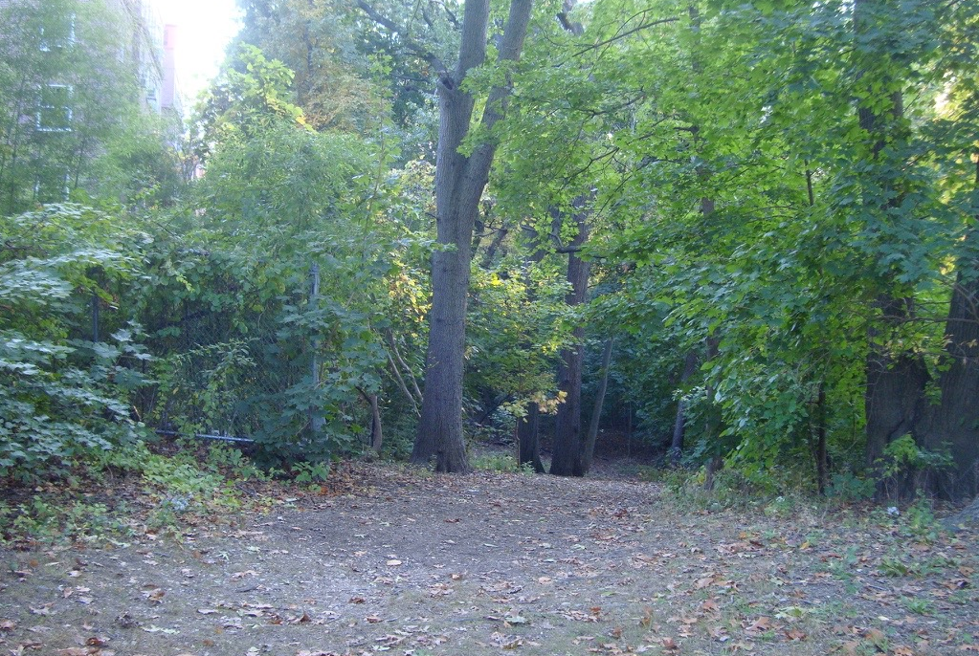
Rugged Terrain of Forest Park

Slide 33
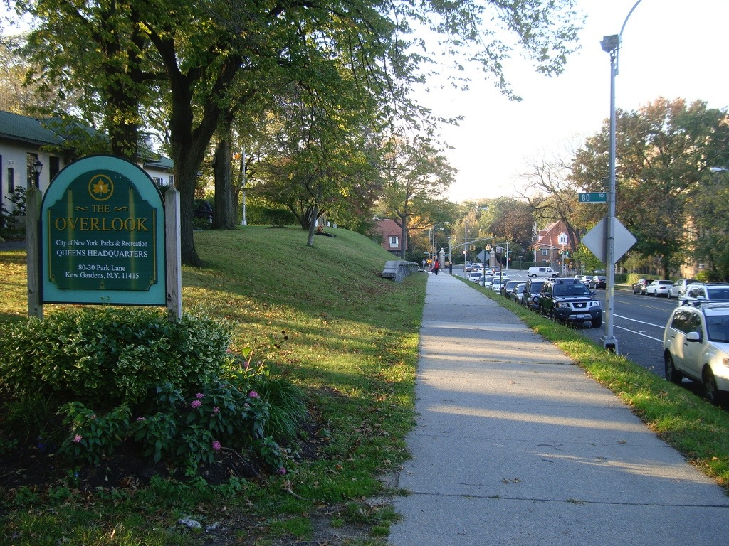
Forest Hills Gardens from Overlook

Slide 34
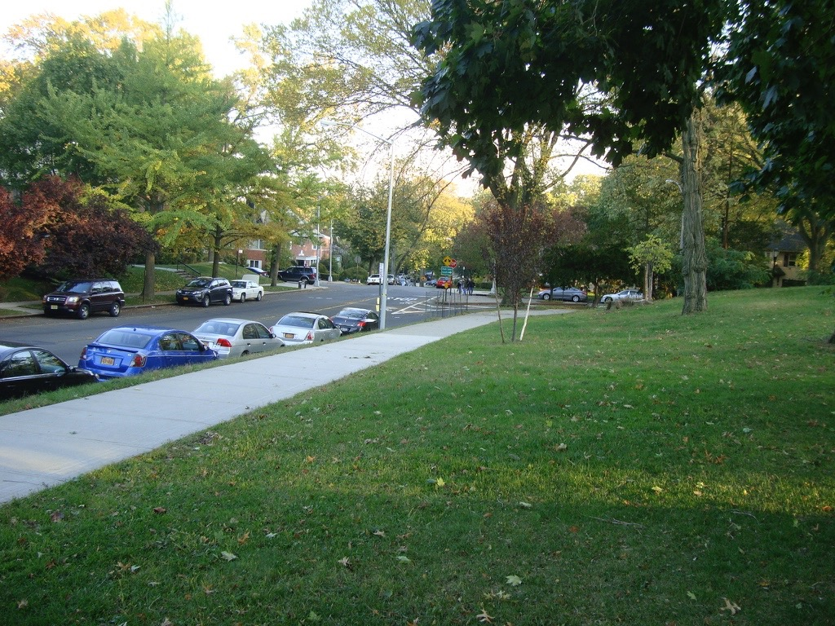
Looking from Overlook Towards former Crystal Lake

Slide 35
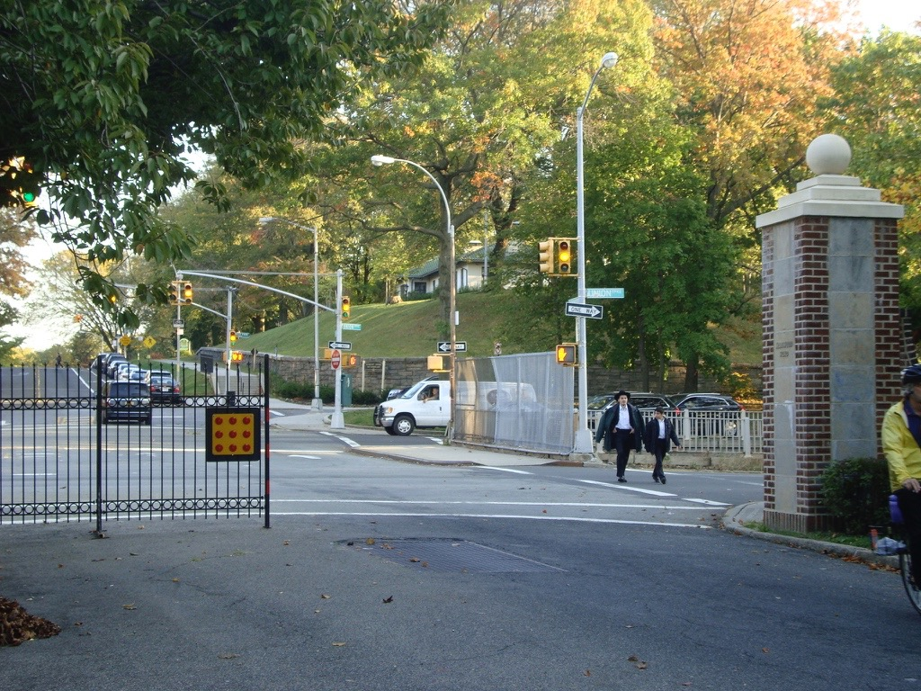
Looking South from Markwood

Slide 36
Gentle Slopes of Markwood Place

Slide 37
Kettle Hole - Deepene

Slide 38
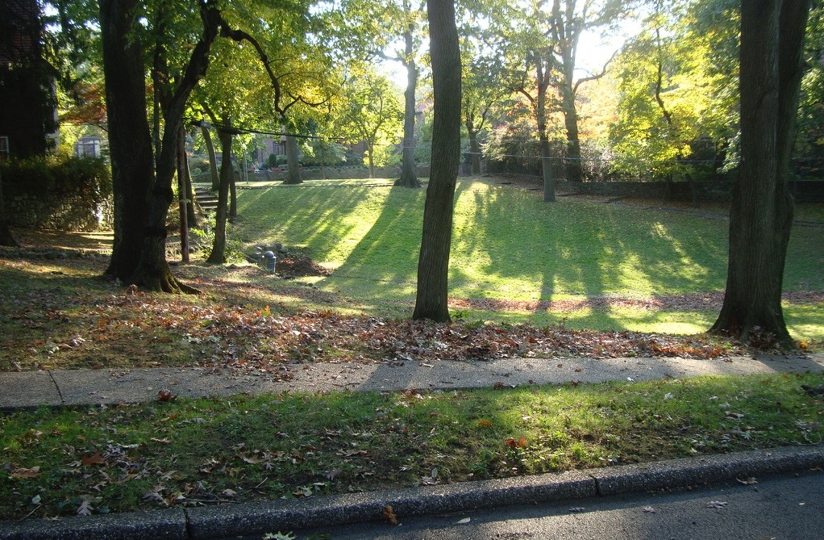
Kettle Hole - Deepene

Slide 39
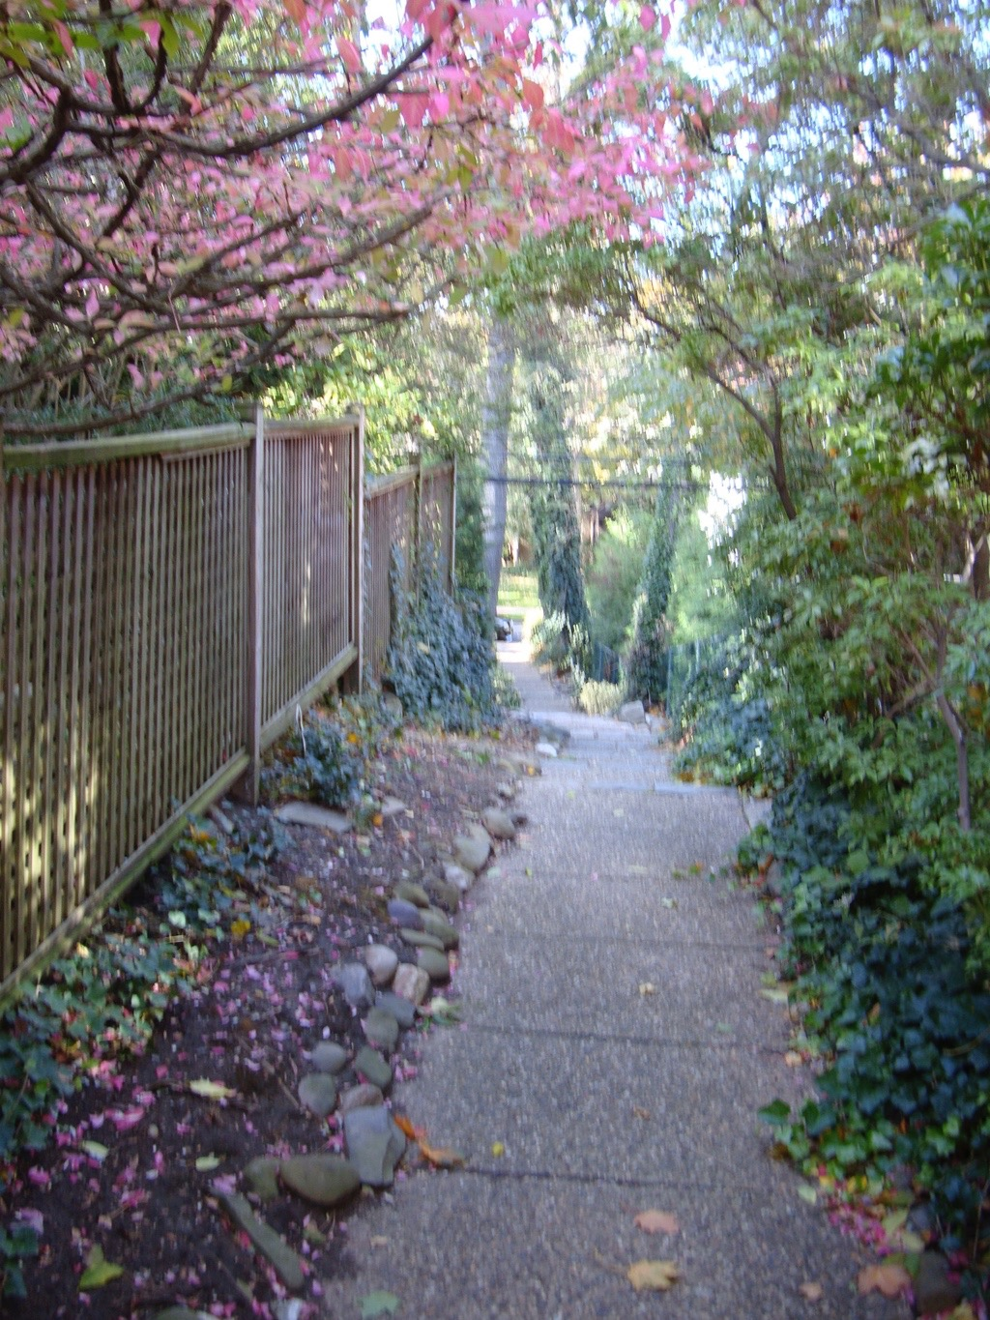
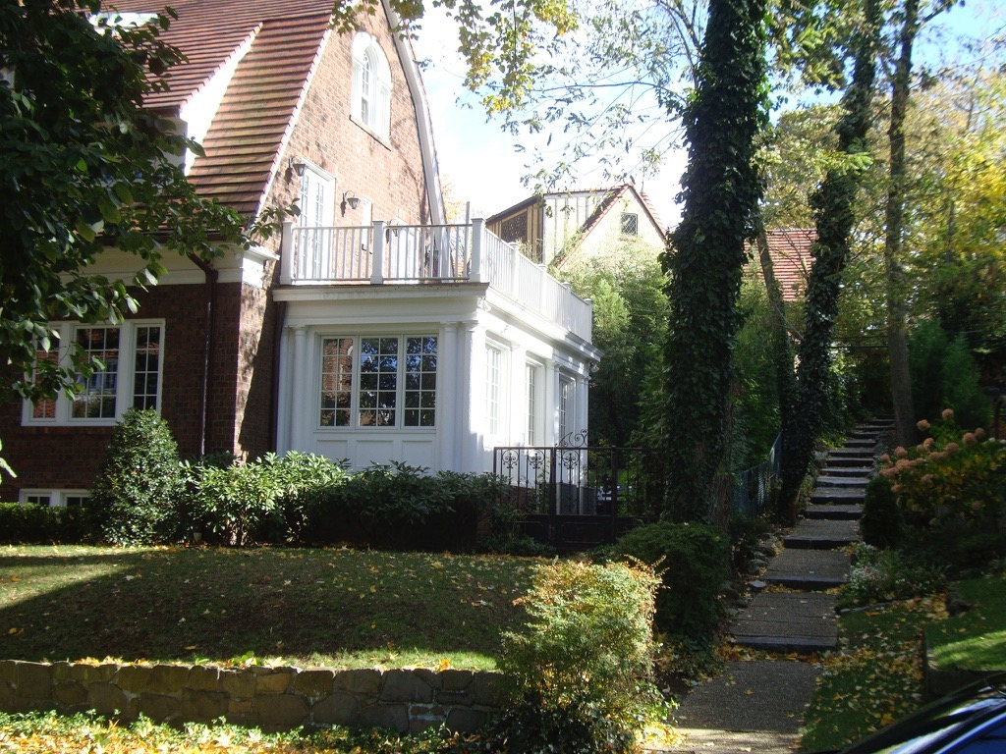
Shorthill Road

Slide 40
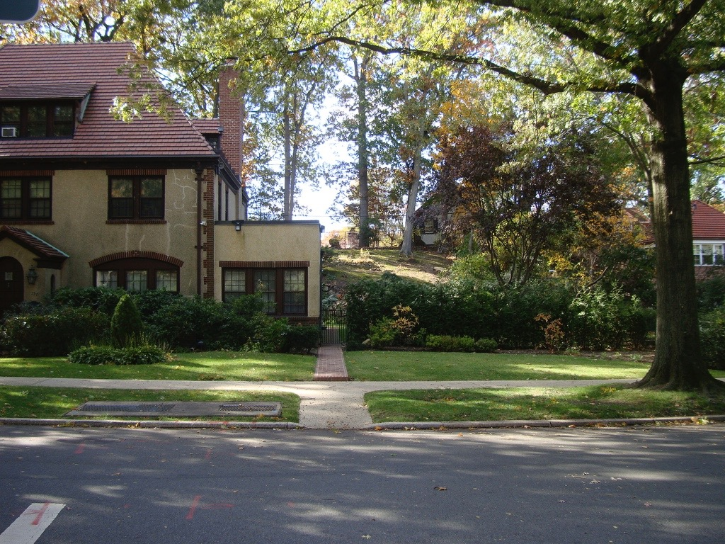
View from Greenway North

Slide 41
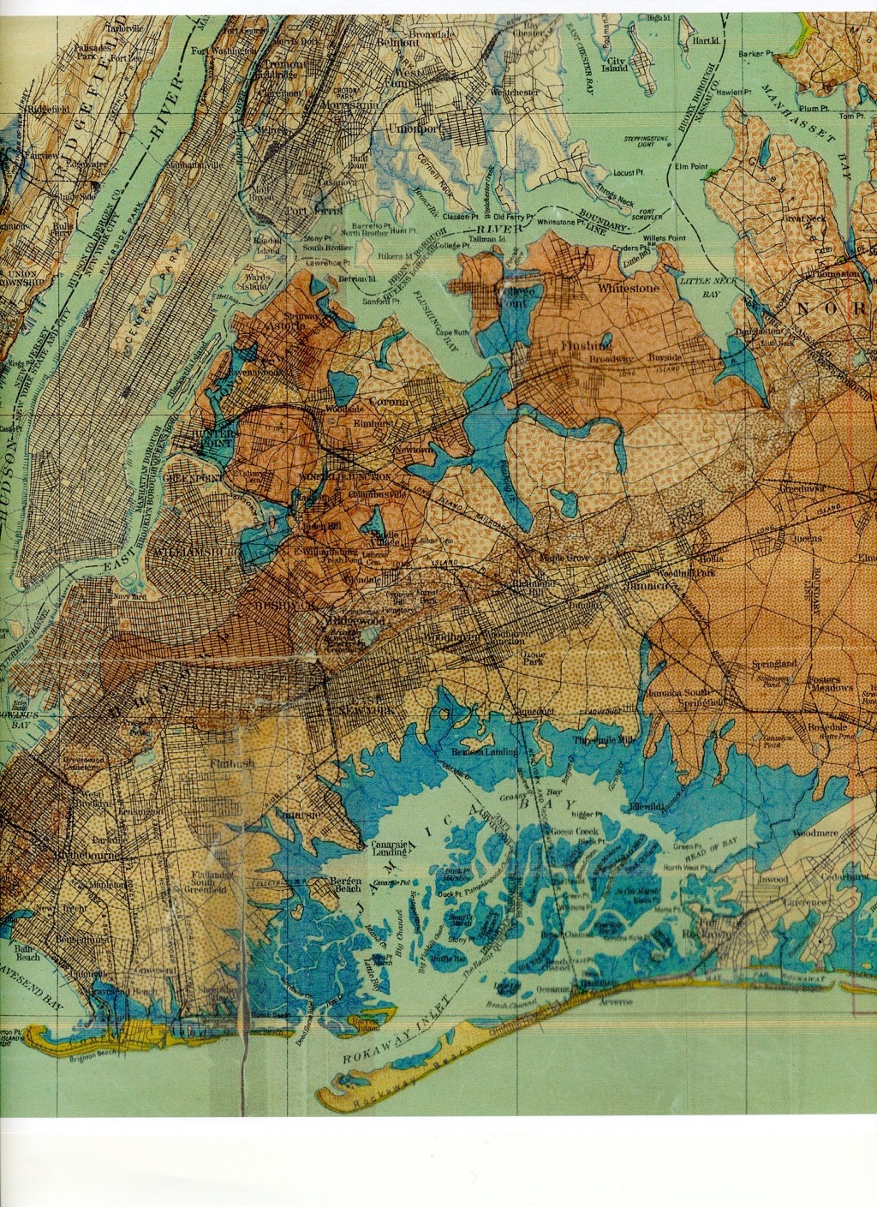
1913 Geologic Map

Slide 42
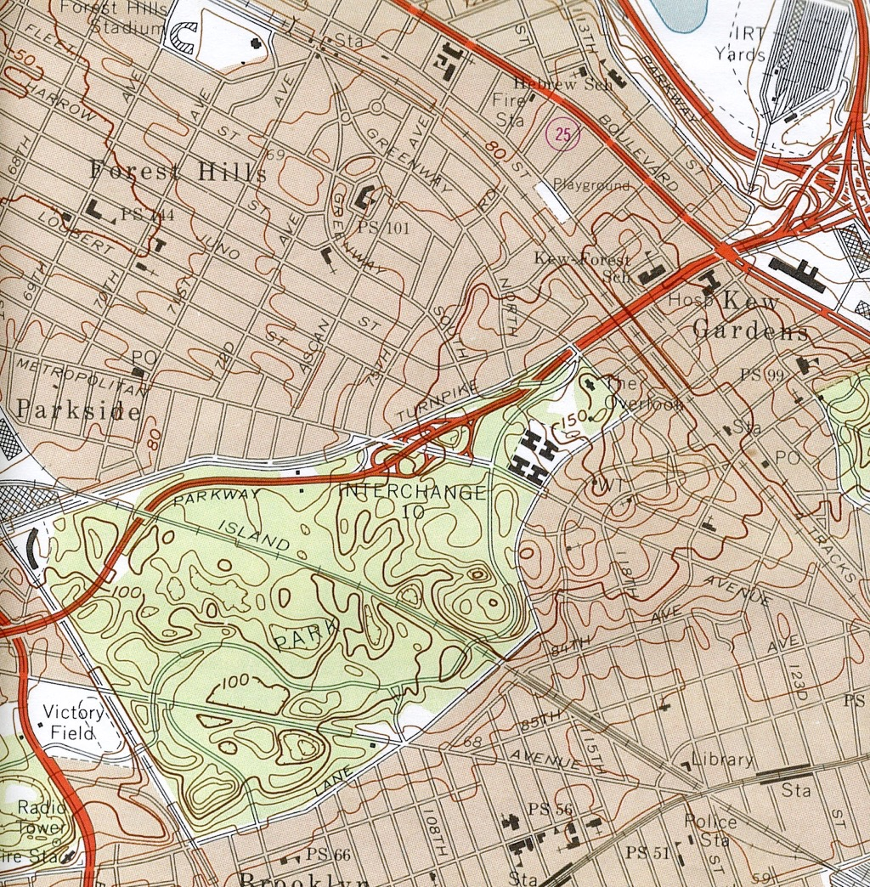
Present Day

Slide 44
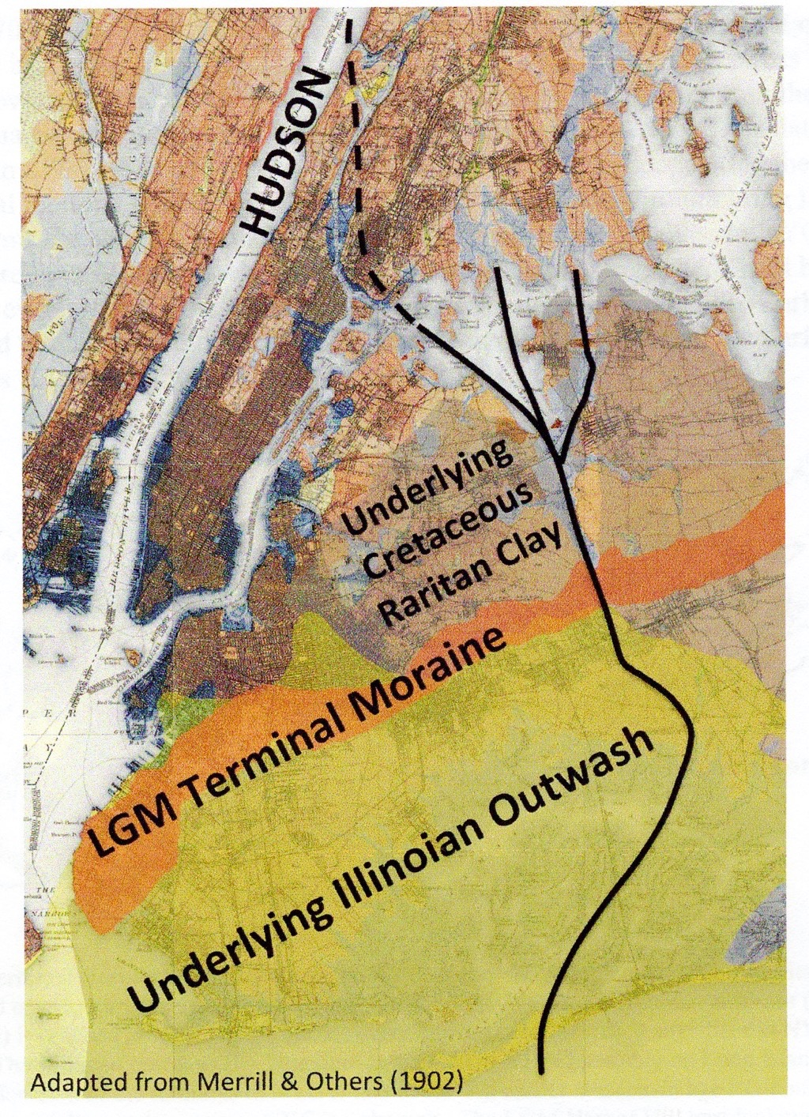
Ancient Hudson River Course

Slide 45
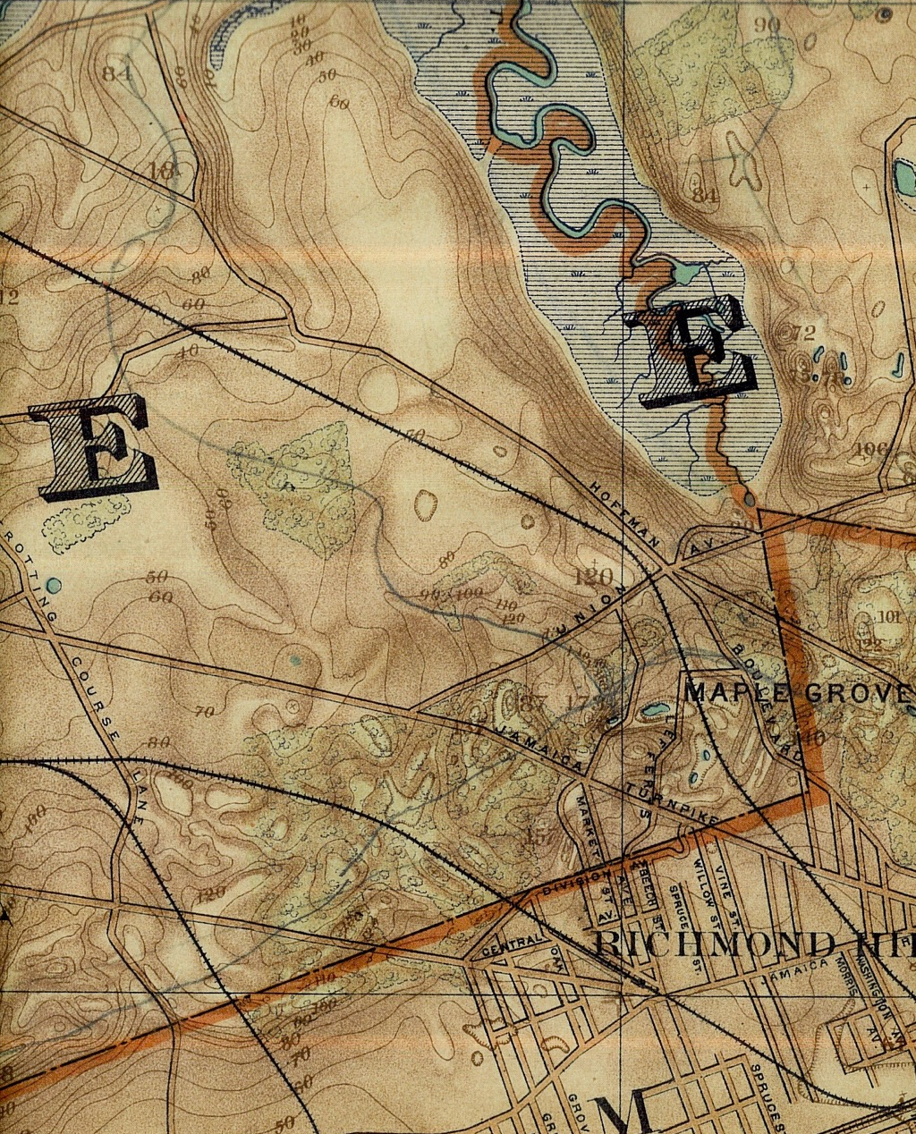
1908 Topography
Enlarged

